Slide 1
Food Classification
&
Nutrition Information
Ravi Dahiya

Slide 2
Business Problems
01
Food Classification
To classify the food on the basis of the provided image
02
Nutrition Information
Provide the nutrition information of the classified item
03
Insulin Units
Provide number of insulin units required after taking the food

Slide 3
Approach

Slide 4
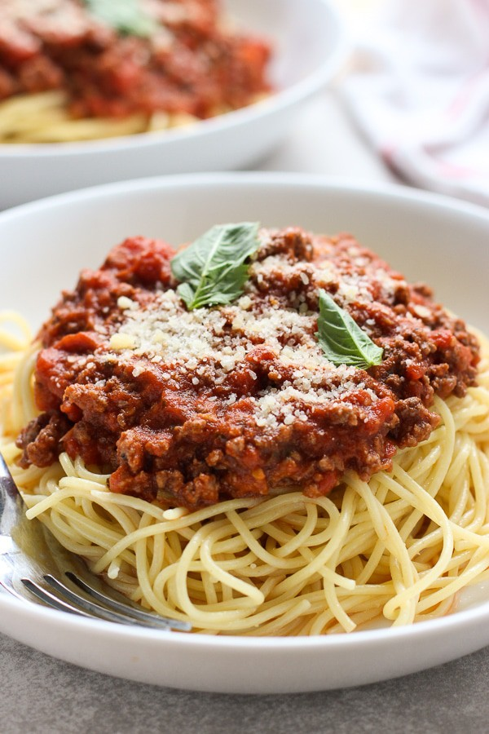
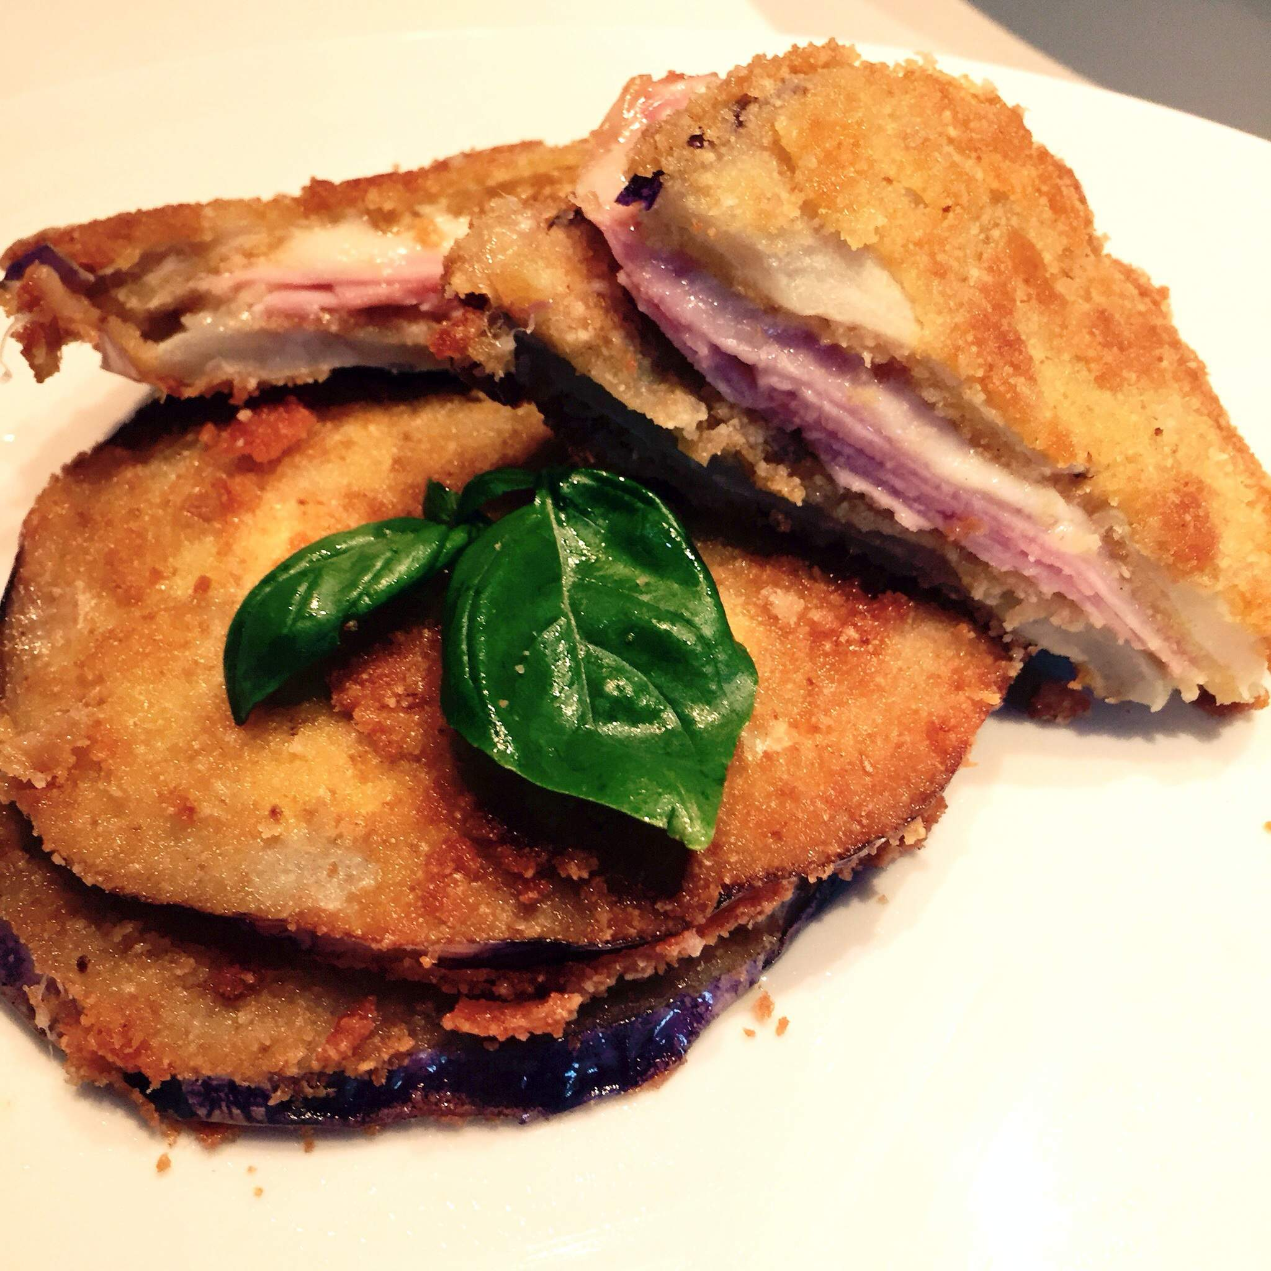
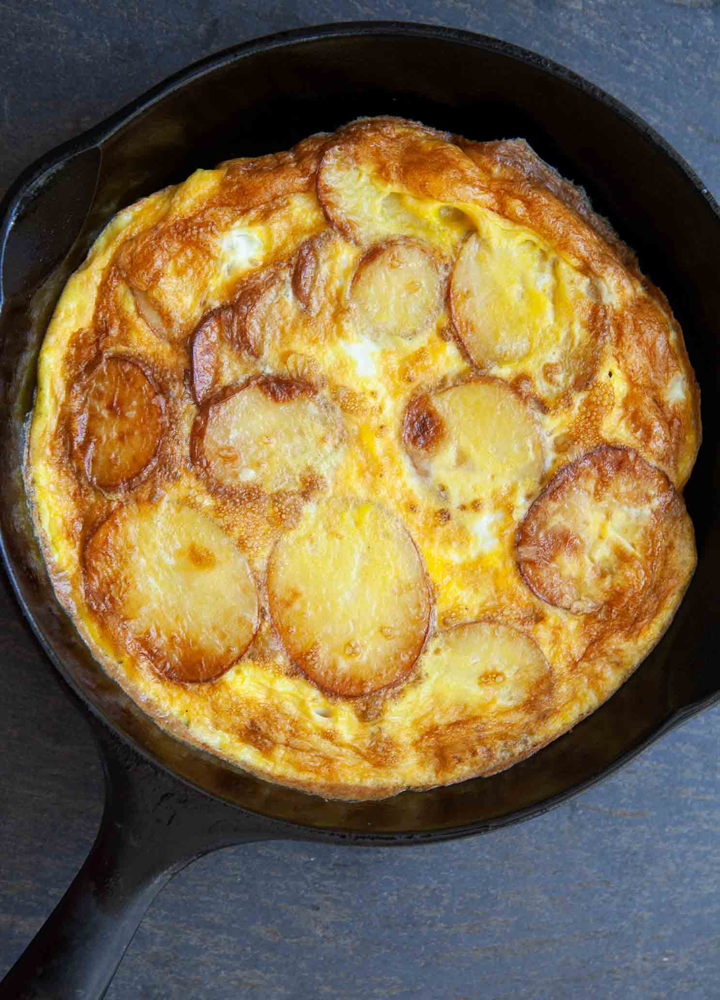
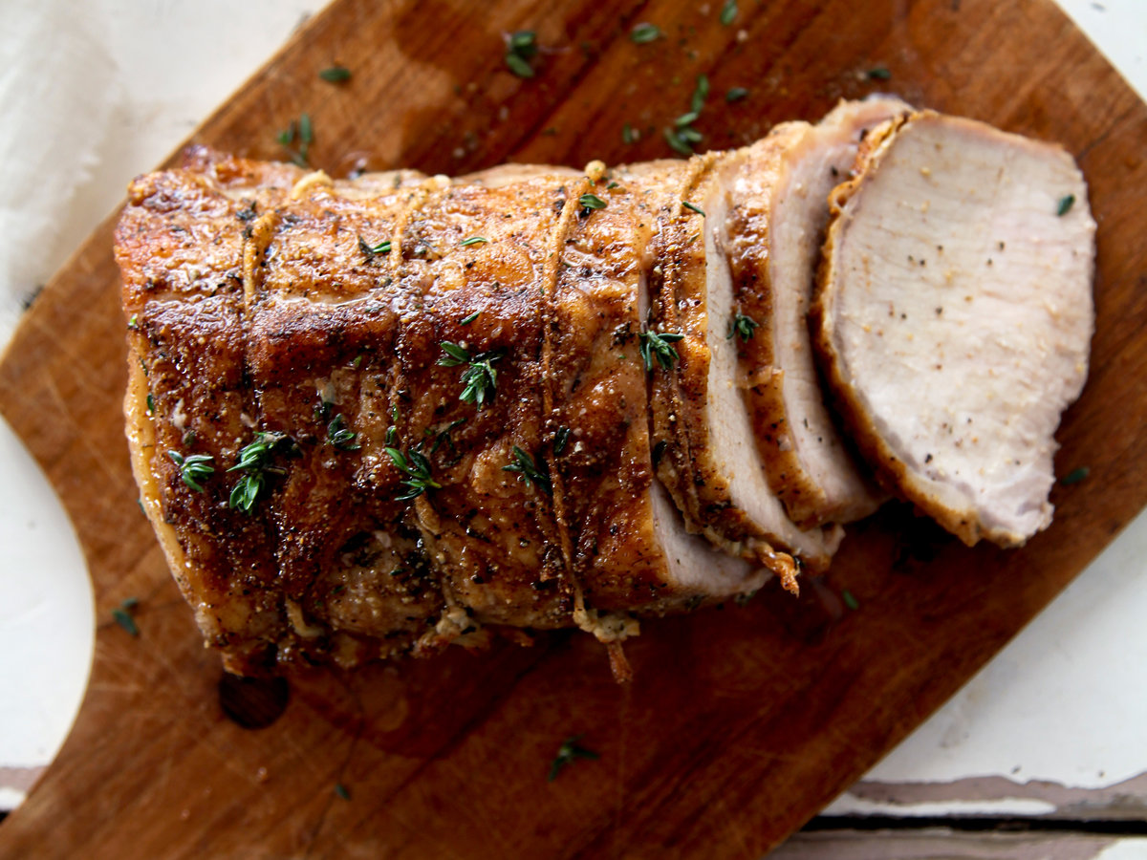
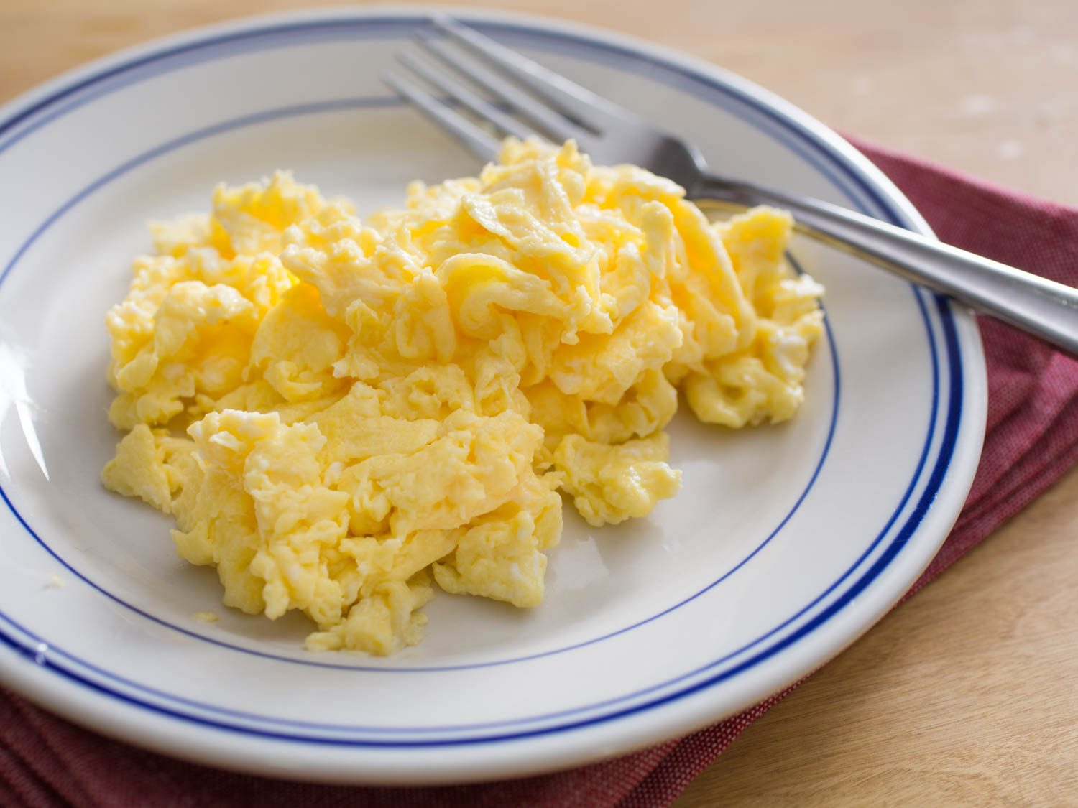
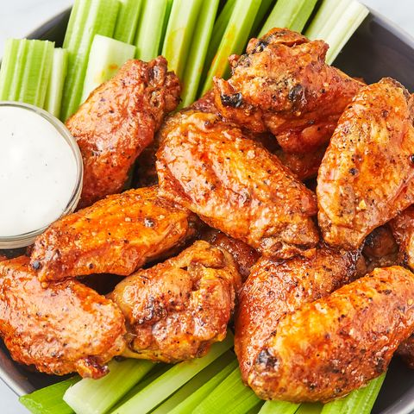
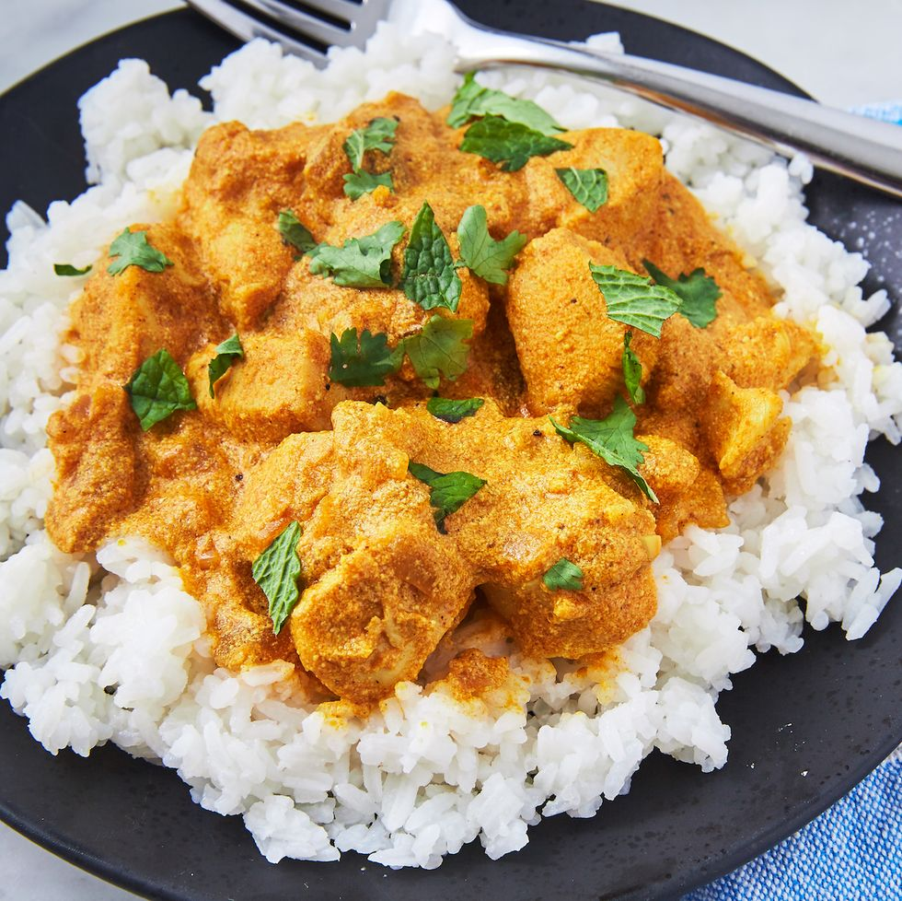
Data
Pasta with meat sauce
Chicken Breast
Omlette with Potatoes
Roasted Pork
Scrambled Eggs
Chicken Wings
Chicken Curry

Slide 5

Convolution Neural Networks

Slide 6
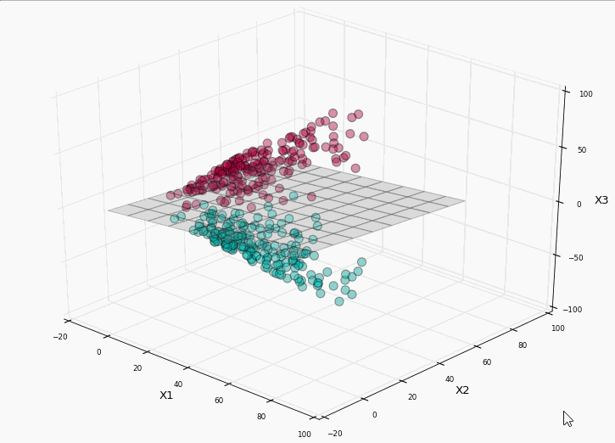
Support Vector Machines

Slide 7
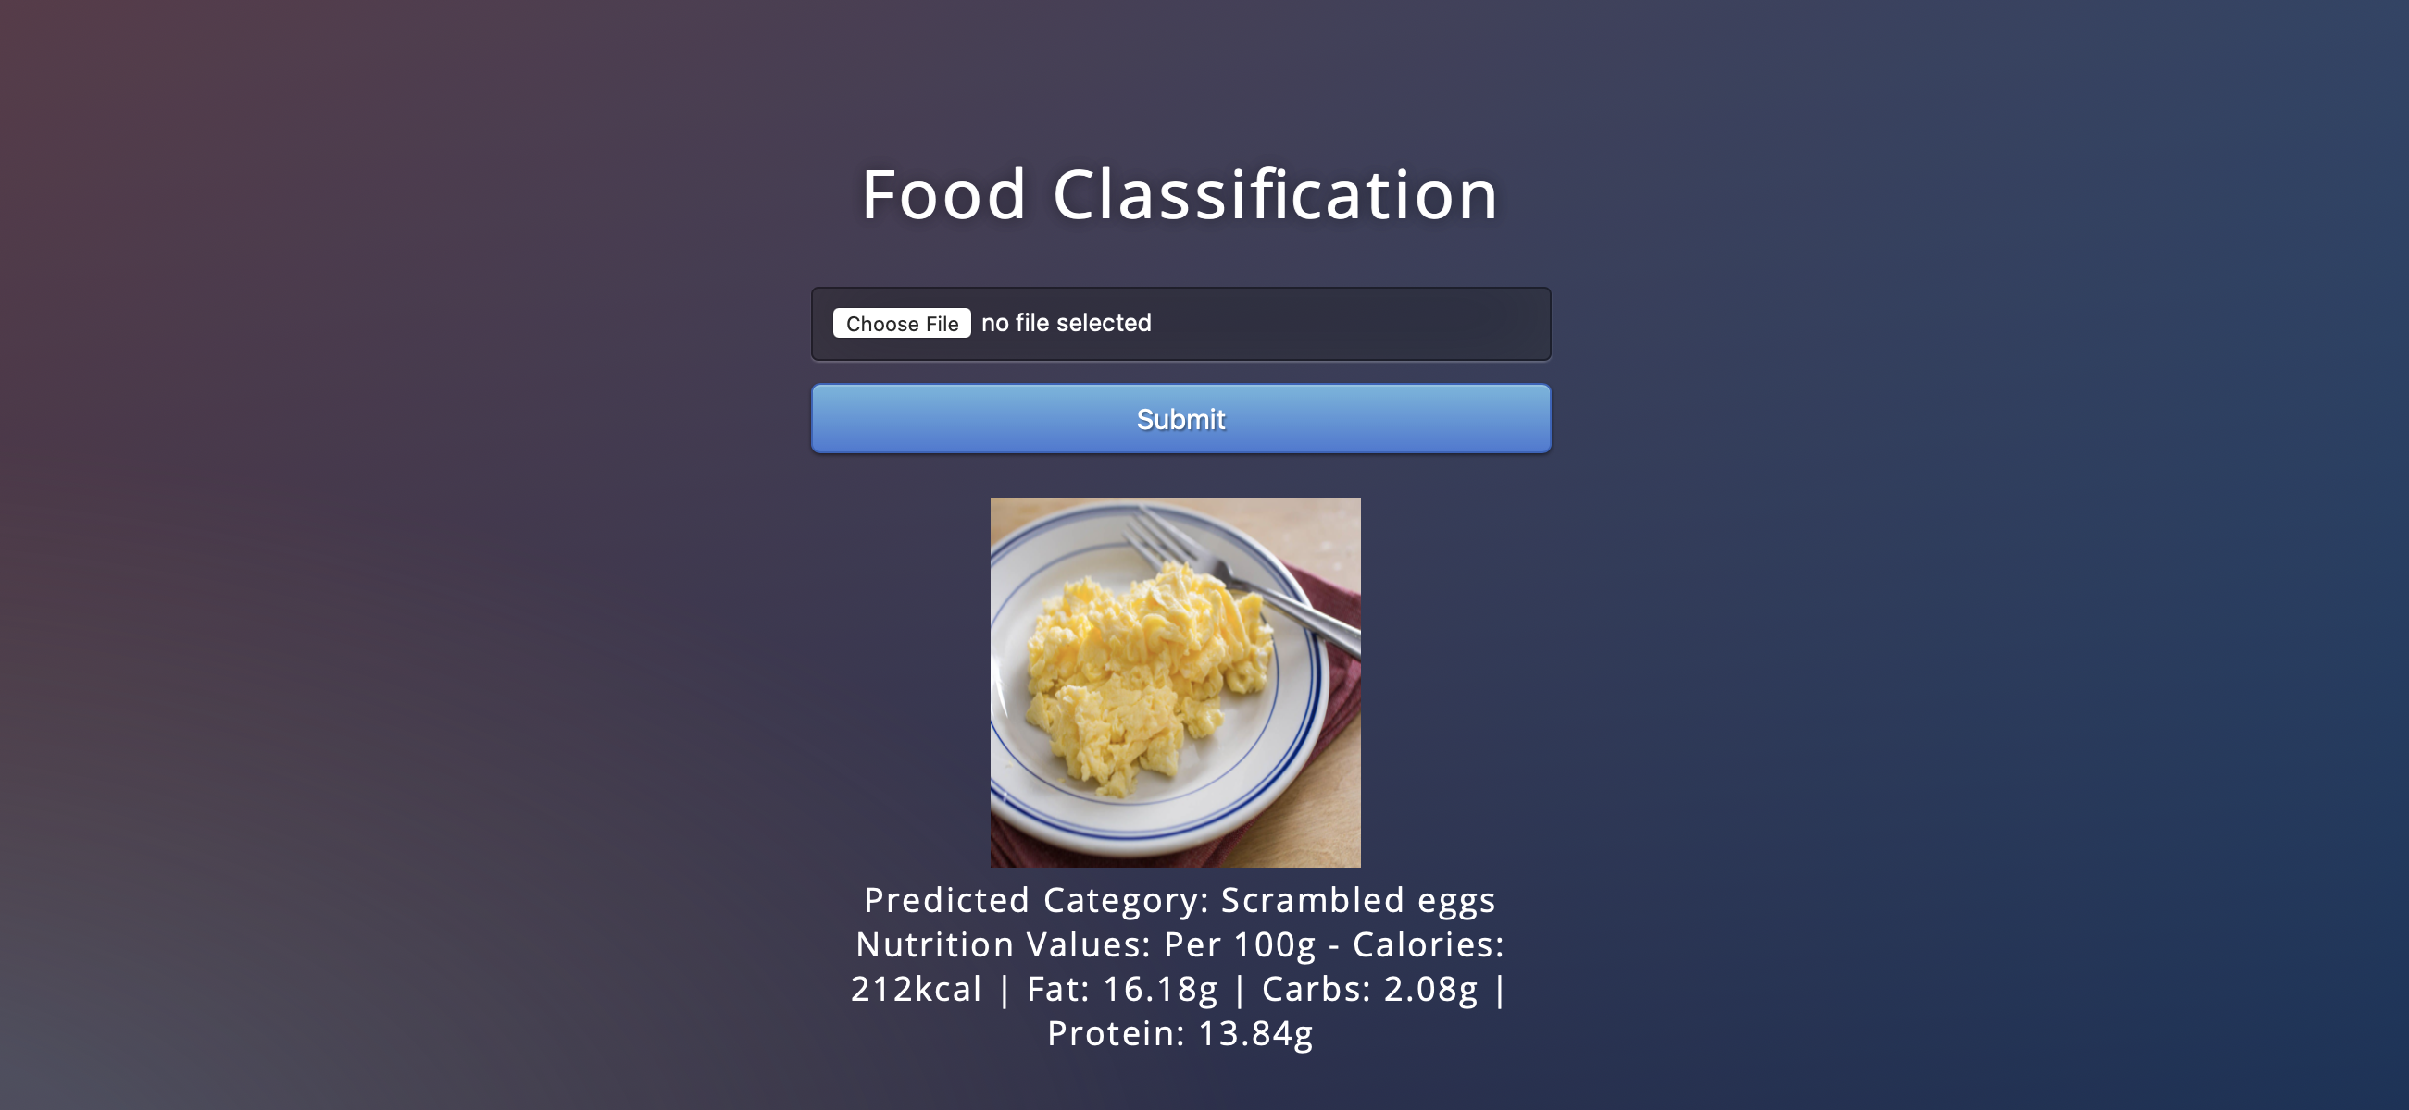
The App (SVM)

Slide 8
Applications
Weight Watchers
As you get nutrition information, you will be able to calculate the calories that you are taking
Diabetic Patients
As the app provides information about the amount of carbs in the food, diabetic patients will be able to calculate the units of insulin. For example (divide the grams of carbs by 20)

Slide 9
Pitfalls
Misclassification
Current Accuracy of 42 percent
Cost of misclassification
Financial and health implications of taking wrong amount of insulin dosage
Always consult the expert

Slide 10
THANK YOU

